Slide 1

ONLINE APPLICATION PROCESSING (OLAP) DATABASE USING SQL.
Dotun Adeleye

Slide 2

SQL Applications and Solutions
INTRODUCTION
DATA MODELLING
DATA AGGREGATION
DATA TRANSFORMATION
DATA SANITIZATION
DATA OPTIMIZATION
CONCLUSION
How can SQL be applied?
Here are some of the reasons why SQL can be an excellent tool for this:
SQL (Structured Query Language) can be an excellent solution for resolving the data management and OLAP database construction issues at VivaK because it is a powerful programming language specifically designed for managing and manipulating structured data.
1
DATA MODELLING
SQL can be used to build Vivak’s OLAP database to support HR analytics
2
DATA AGGREGATION
SQL can be used in Vivak's situation to aggregate data from multiple sources to generate meaningful insights..
3
DATA TRANSFORMATION
So, what’s the problem?
Vivak can use SQL to transform and standardise data gathered from different formats or structures across regions.
The HR department at VivaK, a successful retail chain, lacks robust data management, resulting in data inconsistencies and anomalies. This inconsistency hinders the creation of an OLAP database to support HR analytics efforts, and the organization needs an effective solution to manage HR data efficiently.
4
DATA SANITIZATION
SQL can be used to import and clean Vivak’s data, handle missing values, duplicates or changing input formats.
5
DATA OPTIMIZATION
SQL can be used to fine-tune Vivak’s database configuration settings which can improve querying.

Slide 3
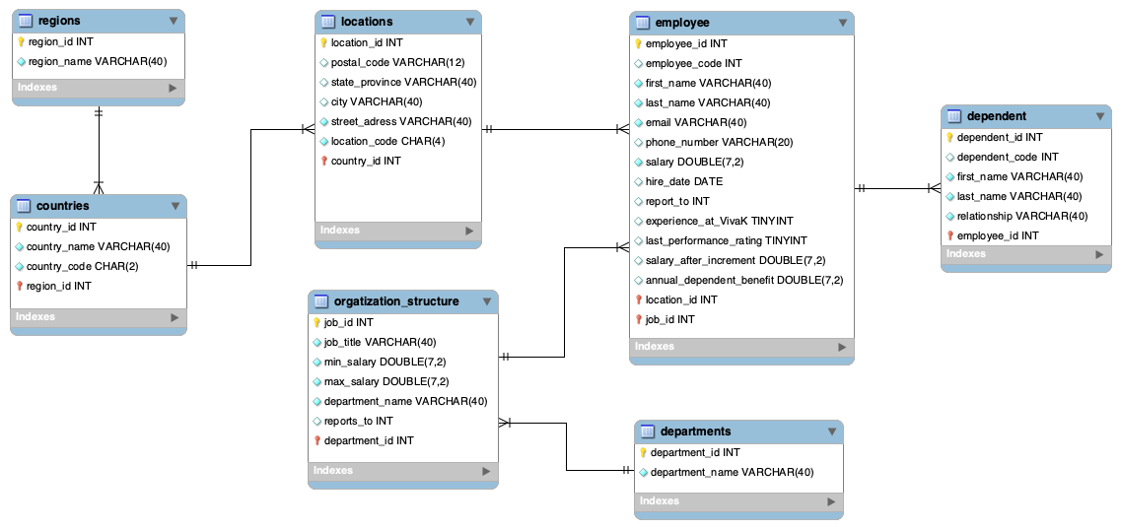
Proposed OLAP Solution
INTRODUCTION
DATA MODELLING
DATA AGGREGATION
DATA TRANSFORMATION
DATA SANITISATION
DATA OPTIMIZATION
CONCLUSION
Objective
Building an OLAP database based on the HR manager’s description of how Vivak entities relate with each other.
Without a unified database, analysts cannot efficiently draw insights from data generated.

Slide 4
Importing and Cleaning Data
INTRODUCTION
DATA MODELLING
DATA AGGREGATION
DATA TRANSFORMATION
DATA SANITIZATION
DATA OPTIMIZATION
CONCLUSION
Database performance testing
DUPLICATE HANDLING
TREATING MISSING VALUES
TABLES | MISSING VALUES | SOLUTION
Dependents | Employee_id had 79 missing values. | Omitted, evidence points to them being associated with former employees.
Employees | Manager_id column was blank. | Resolved by matching employees to their managers from the org_structure table.
Employees | Salary column had 193 missing values. | Replaced those columns with the minimum salary range for positions those employees held.
Scanned through every table received for duplicates using:
SELECT ‘candidate keys’ FROM ‘Table’ GROUP BY ‘candidate keys’ HAVING count(*)>1;
Result: Found that the dependent_id from the dependents table was duplicated.
Solution: Retained the dependent_id but created a new column named dependent_code which served as the primary key.

Slide 5
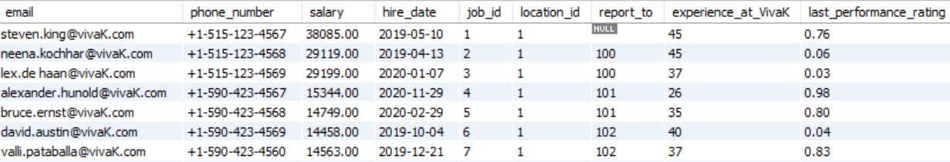
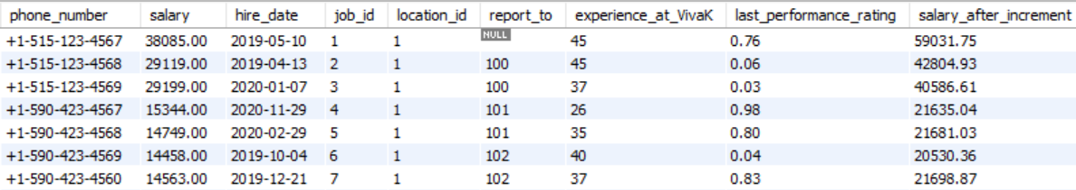
Derived Attributes
INTRODUCTION
DATA MODELLING
DATA SANITIZATION
DATA TRANSFORMATION
DATA AGGREGATION
DATA OPTIMIZATION
CONCLUSION
Calculations used to test performance.
experience_at_Vivak and last_performance_rating were generated.
Salary_after_increment was generated based on the last_performance_rating column.

Slide 6
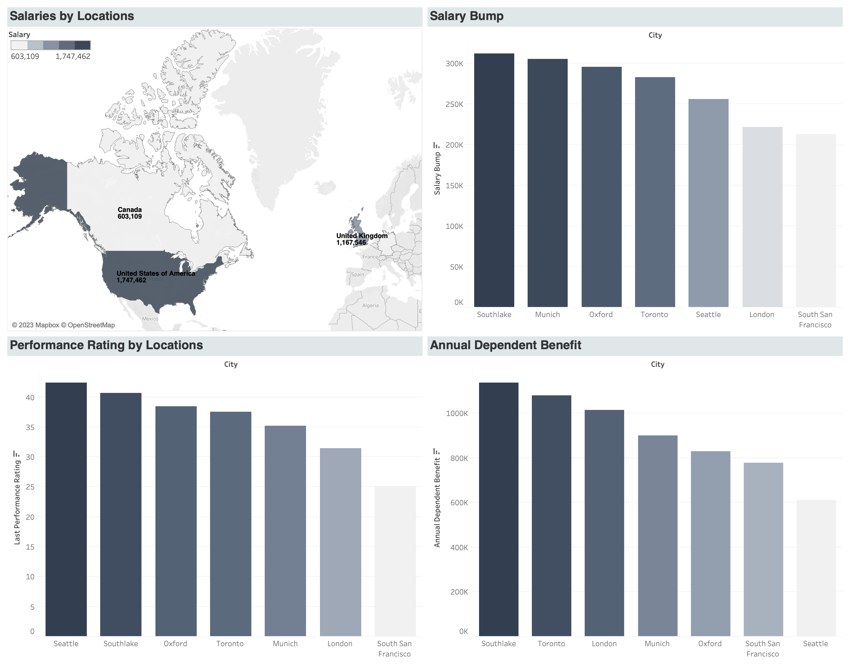
Insights
INTRODUCTION
DATA MODELLING
DATA AGGREGATION
DATA TRANSFORMATION
DATA SANITISATION
DATA OPTIMIZATION
CONCLUSION
Tableau Visualizations

Slide 7

INTRODUCTION
DATA MODELLING
DATA AGGREGATION
DATA TRANSFORMATION
DATA SANITISATION
DATA OPTIMIZATION
CONCLUSION
THANK YOU FOR YOUR TIME!
Link to Script

